Slide 1
Software Testing & Quality
(02)-Domain Testing
陈振宇
南京大学软件学院
http://software.nju.edu.cn/zychen

Slide 2
Domain Testing
Domain testing is to partition the input domain into subdomains and then select some representative data from each subdomain for testing.
Domain testing/equivalence class testing/ partition testing, etc.

Slide 3
Benefits of DT
Can be equally applied at several levels of testing
  Unit
  Integration
  System
Relatively easy to apply with no automation
Easy to adjust the procedure to get more or fewer tests
No implementation knowledge is needed
  just the input domain

Slide 4
Input Domains
The input domain to a program contains all the possible inputs to that program
For even small programs, the input domain is so large that it might as well be infinite
Testing is fundamentally about choosing finite sets of values from the input domain
Input parameters define the scope of the input domain
  Parameters to a method
  Data read from a file
  Global variables
  User level inputs
Domain for each input parameter is partitioned into regions
At least one value is chosen from each region

Slide 5
Partitioning Domains
Domain D
Partition scheme q of D
The partition q defines a set of blocks, Bq = b₁ , b₂ , … b_{Q}
The partition must satisfy two properties :
  blocks must be pairwise disjoint (no-overlap)
  together the blocks cover the domain D (complete)

Slide 6
Using Partitions – Assumptions
Choose a value from each partition
Each value is assumed to be equally useful for testing
Application to testing
  Find characteristics in the inputs : parameters, semantic descriptions, …
  Partition each characteristic
  Choose tests by combining values from characteristics
Example Characteristics
  Input X is null
  Order of the input file F (sorted, inverse sorted, arbitrary, …)
  Min separation of two aircraft
  Input device (DVD, CD, VCR, computer, …)

Slide 7
Choosing Partitions
Choosing (or defining) partitions seems easy, but is easy to get wrong
Consider the “order of file F”
b₁ = sorted in ascending order
b₂ = sorted in descending order
b₃ = arbitrary order
Solution:
Each characteristic should address just one property
but … something’s fishy …
File F sorted ascending
- b1 = true
- b2 = false
File F sorted descending
- b1 = true
- b2 = false
What if the file is of length 1?
The file will be in all three blocks …
That is, disjointness is not satisfied

Slide 8
Equivalence Classes
Equivalence Relation, R, is a relation defined on the set A such that it is reflexive, transitive, and symmetric: let € to mean an “element of”
  Reflexive: z€A, then (z,z) € R
  Symmetric: (a,b) € R then (b,a) € R, for all a,b in A
  Transitive : (p,q) € R and (q,r) € R, then (p,r) € R for all p,q,r in A
Equivalence class testing is the partitioning of the (often times, but not always) input variable’s value set into classes (subsets) using some equivalence relation.

Slide 9
Equivalence Class Test Cases
Consider a numerical input variable, i, whose values may range from -200 through +200. Then a possible partitioning of testing input variable by 4 people may be:
  -200 to -100
  -101 to 0
  1 to 100
  101 to 200
Define “same sign” as the equivalence relation, R, defined over the input variable’s value set, i = {-200 - -,0, - -, +200}. Then one partitioning will be:
  -200 to -1 (negative sign)
  0 (no sign)
  1 to 200 (positive sign)
“same sign” relation is an equivalence relation: (let ‘ε’ be “element of”)
  reflexive : -2 ε Input Variable then (-2, -2) ε R
  symmetric : (3, 5) ε R, then (5, 3) ε R
  transitive: (-5, -7) ε R and (-7, -200) ε R , then (-5, -200) ε R

Slide 10
Weak Equivalence Testing
Assumes the ‘single fault’ or “independence of input variables.”
  e.g. If there are 2 input variables, these input variables are independent of each other.
Partition the test cases of each input variable separately into different equivalent classes.
Choose the test case from each of the equivalence classes for each input variable independently of the other input variable

Slide 11
Example of : Weak Equivalence Testing
Assume the equivalence partitioning of input X is: 1 to 10; 11 to 20, 21 to 30
and the equivalence partitioning of input Y is: 1 to 5; 6 to 10; 11;15; and 16 to 20
X
We have covered everyone
of the 3 equivalence classes
for input X.
30
20
For ( x, y )
we have:
(24, 2)
(15, 8 )
( 4, 13)
(23, 17)
10
1
Y
1
5
10
15
20
General rule for # of test cases?
What do you think?
# of partitions of the largest set?
We have covered each of the 4 equivalence classes for input Y.

Slide 12
Strong Equivalence Testing
This is the same as the weak normal equivalence testing except for
“multiple fault assumption”
or
“dependence among the inputs”
All the combinations of equivalence classes of the variables must be included.

Slide 13
Example of : Strong Equivalence Testing
Assume the equivalence partitioning of input X is: 1 to 10; 11 to 20, 21 to 30
and the equivalence partitioning of input Y is: 1 to 5; 6 to 10; 11;15; and 16 to 20
X
30
We have covered everyone
of the 3 x 4 Cartesian product of equivalence
classes
20
10
1
Y
1
5
10
15
20
General rule for # of test cases?
What do you think?

Slide 14
Weak Robust Equivalence Testing
Up to now we have only considered partitioning the valid input space.
“Weak robust” is similar to “weak normal” equivalence test except that the invalid input variables are now considered.
A note about considering invalid input is that there may not
be any definition “specified” for the various, different invalid
inputs - - - making definition of the output for these invalid
inputs a bit difficult at times. (but fertile ground for testing)

Slide 15
Example of : Weak Robust Equivalence Testing
Assume the equivalence partitioning of input X is 1 to 10; 11 to 20, 21 to 30
and the equivalence partitioning of input Y is 1 to 5; 6 to 10; 11;15; and 16 to 20
X
30
We have covered everyone of the 5 equivalence classes for input X.
20
10
1
Y
1
5
10
15
20
We have covered each of the 6 equivalence classes for input Y.

Slide 16
Strong Robust Equivalence Testing
Does not assume “single fault” - - - assumes dependency of input variables
“Strong robust” is similar to “strong normal” equivalence test except that the invalid input variables are now considered.

Slide 17
Example of : Strong Robust Equivalence testing
Assume the equivalence partitioning of input X is: 1 to 10; 11 to 20, 21 to 30
and the equivalence partitioning of input Y is: 1 to 5; 6 to 10; 11;15; and 16 to 20
X
30
We have covered everyone
of the 5 x 6 Cartesian product of equivalence
classes (including invalid
inputs)
20
10
1
Y
1
5
10
15
20

Slide 18
Properties of Partitions
If the partitions are not complete or disjoint, that means the partitions have not been considered carefully enough
They should be reviewed carefully, like any design attempt
Different alternatives should be considered
We model the input domain in five steps …

Slide 19
Modeling the Input Domain
Step 1 : Identify testable functions
  Individual methods have one testable function
  In a class, each method often has the same characteristics
  Programs have more complicated characteristics—modeling documents such as UML use cases can be used to design characteristics
  Systems of integrated hardware and software components can use devices, operating systems, hardware platforms, browsers, etc
Step 2 : Find all the parameters
  Often fairly straightforward, even mechanical
  Important to be complete
  Methods : Parameters and state (non-local) variables used
  Components : Parameters to methods and state variables
  System : All inputs, including files and databases

Slide 20
Modeling the Input Domain
Step 3 : Model the input domain
  The domain is scoped by the parameters
  The structure is defined in terms of characteristics
  Each characteristic is partitioned into sets of blocks
  Each block represents a set of values
  This is the most creative design step in applying DT
Step 4 : Apply a test criterion to choose combinations of values
  A test input has a value for each parameter
  One block for each characteristic
  Choosing all combinations is usually infeasible
  Coverage criteria allow subsets to be chosen
Step 5 : Refine combinations of blocks into test inputs
  Choose appropriate values from each block

Slide 21
Two Approaches to Input Domain Modeling
Interface-based approach
  Develops characteristics directly from individual input parameters
  Simplest application
  Can be partially automated in some situations
Functionality-based approach
  Develops characteristics from a behavioral view of the program under test
  Harder to develop—requires more design effort
  May result in better tests, or fewer tests that are as effective
Introduction to Software Testing (Ch 4)
© Ammann & Offutt

Slide 22
1. Interface-Based Approach
Mechanically consider each parameter in isolation
This is an easy modeling technique and relies mostly on syntax
Some domain and semantic information won’t be used
  Could lead to an incomplete IDM
Ignores relationships among parameters
Consider TriTyp from Chapter 3
Three int parameters
IDM for each parameter is identical
Reasonable characteristic : Relation of side with zero

Slide 23
2. Functionality-Based Approach
Identify characteristics that correspond to the intended functionality
Requires more design effort from tester
Can incorporate domain and semantic knowledge
Can use relationships among parameters
Modeling can be based on requirements, not implementation
The same parameter may appear in multiple characteristics, so it’s harder to translate values to test cases
Consider TriTyp again
The three parameters represent a triangle
IDM can combine all parameters
Reasonable characteristic : Type of triangle

Slide 24
Steps 1 & 2 – Identifying Functionalities, Parameters and Characteristics
A creative engineering step
More characteristics means more tests
Interface-based : Translate parameters to characteristics
Candidates for characteristics :
  Preconditions and postconditions
  Relationships among variables
  Relationship of variables with special values (zero, null, blank, …)
Should not use program source – characteristics should be based on the input domain
  Program source should be used with graph or logic criteria
Better to have more characteristics with few blocks
  Fewer mistakes and fewer tests

Slide 25
Steps 1 & 2 : Interface vs Functionality-Based
public boolean findElement (List list, Object element)
// Effects: if list or element is null throw NullPointerException
// else return true if element is in the list, false otherwise
Interface-Based Approach
Two parameters : list, element
Characteristics :
list is null (block1 = true, block2 = false)
list is empty (block1 = true, block2 = false)
Functionality-Based Approach
Two parameters : list, element
Characteristics :
number of occurrences of element in list
(0, 1, >1)
element occurs first in list
(true, false)
element occurs last in list
(true, false)

Slide 26
Step 3 : Modeling the Input Domain
Partitioning characteristics into blocks and values is a very creative engineering step
More blocks means more tests
The partitioning often flows directly from the definition of characteristics and both steps are sometimes done together
  Should evaluate them separately – sometimes fewer characteristics can be used with more blocks and vice versa
Strategies for identifying values :
  Include valid, invalid and special values
  Sub-partition some blocks
  Explore boundaries of domains
  Include values that represent “normal use”
  Try to balance the number of blocks in each characteristic
  Check for completeness and disjointness

Slide 27
Interface-Based IDM – TriTyp
TriTyp, from Chapter 3, had one testable function and three integer inputs
First Characterization of TriTyp’s Inputs
Characteristic | b₁ | b₂ | b₃
q₁ = “Relation of Side 1 to 0” | greater than 0 | equal to 0 | less than 0
q₂ = “Relation of Side 2 to 0” | greater than 0 | equal to 0 | less than 0
q₃ = “Relation of Side 3 to 0” | greater than 0 | equal to 0 | less than 0
A maximum of 3*3*3 = 27 tests
Some triangles are valid, some are invalid
Refining the characterization can lead to more tests …

Slide 28
Interface-Based IDM – TriTyp
Second Characterization of TriTyp’s Inputs
Characteristic | b₁ | b₂ | b₃ | b₄
q₁ = “Refinement of q₁” | greater than 1 | equal to 1 | equal to 0 | less than 0
q₂ = “Refinement of q₂” | greater than 1 | equal to 1 | equal to 0 | less than 0
q₃ = “Refinement of q₃” | greater than 1 | equal to 1 | equal to 0 | less than 0
A maximum of 4*4*4 = 64 tests
This is only complete because the inputs are integers (0 . . 1)
Possible values for partition q₁
Characteristic | b₁ | b₂ | b₃ | b₄
Side1 | 5 | 1 | 0 | -5
2
-1
Test boundary conditions
© Ammann & Offutt

Slide 29
Functionality-Based IDM – TriTyp
First two characterizations are based on syntax–parameters and their type
A semantic level characterization could use the fact that the three integers represent a triangle
Geometric Characterization of TriTyp’s Inputs
Characteristic | b₁ | b₂ | b₃ | b₄
q₁ = “Geometric Classification” | scalene | isosceles | equilateral | invalid
Oops … something’s fishy … equilateral is also isosceles !
We need to refine the example to make characteristics valid
Correct Geometric Characterization of TriTyp’s Inputs
Characteristic | b₁ | b₂ | b₃ | b₄
q₁ = “Geometric Classification” | scalene | isosceles, not equilateral | equilateral | invalid

Slide 30
Functionality-Based IDM – TriTyp
Values for this partitioning can be chosen as
Possible values for geometric partition q₁
Characteristic | b₁ | b₂ | b₃ | b₄
Triangle | (4, 5, 6) | (3, 3, 4) | (3, 3, 3) | (3, 4, 8)

Slide 31
Functionality-Based IDM – TriTyp
A different approach would be to break the geometric characterization into four separate characteristics
Four Characteristics for TriTyp
Characteristic | b₁ | b₂
q₁ = “Scalene” | True | False
q₂ = “Isosceles” | True | False
q₃ = “Equilateral” | True | False
q₄ = “Valid” | True | False
Use constraints to ensure that
  Equilateral = True implies Isosceles = True
  Valid = False implies Scalene = Isosceles = Equilateral = False

Slide 32
Using More than One IDM
Some programs may have dozens or even hundreds of parameters
Create several small IDMs
  A divide-and-conquer approach
Different parts of the software can be tested with different amounts of rigor
  For example, some IDMs may include a lot of invalid values
It is okay if the different IDMs overlap
  The same variable may appear in more than one IDM

Slide 33
Step 4 – Choosing Combinations of Values
Once characteristics and partitions are defined, the next step is to choose test values
We use criteria – to choose effective subsets
The most obvious criterion is to choose all combinations …
Number of tests is the product of the number of blocks in each characteristic :
Π
Q
(B_{i})
i=1
The second characterization of TriTyp results in 4*4*4 = 64 tests – too many ?

Slide 34
Boundary Value Analysis
We have earlier looked at domain testing as a simple strategy for selecting test cases. We will now take this a step further.
Testers have frequently observed that domain boundaries are particularly fault prone and should therefore be carefully checked.

Slide 35
Boundary Value
Based on experience/heuristics:
  Testing boundary conditions of eq. classes is more effective
    i.e. values directly on, above, and beneath edges of classes
  Choose input boundary values as tests in input classes
    instead of, or additional to arbitrary values
  Choose also inputs that invoke output boundary values
    ( values on the boundary of output classes )
Example strategy as extension of equivalence partitioning:
  choose one (n) arbitrary value(s) in each eq. class
  choose values exactly on lower/upper boundaries of eq. class
  choose values immediately below/above each boundary
  ( if applicable )
Notes:
Heuristic：（教育或教学）启发式的
Extension：扩大
Arbitrary：随意的

Slide 36
Guidelines for Identifying Boundary Values
1. If the input range is bounded by a and b, then use a, b, and values just above and just below a and b, respectively
2. If the input is a number of values, use the minimum and maximum of the values and values just above and just below them, respectively
3. Apply guidelines 1 and 2 to create output values at the minimum and maximum expected values
4. If data structures have boundaries, test these boundary values and values just above and just below them, respectively
  e.g., for an array of bounds 1 to 10, test array index equal to 0, 1,2, 9, 10, 11
a
b
a
b

Slide 37
BVA Example
Test a function for calculation of absolute value of an integer
Valid equivalence classes :
Test cases :
  class x < 0, arbitrary value: x = -10
  class x >= 0, arbitrary value: x = 100
  classes x < 0, x >= 0, on boundary : x = 0
  classes x < 0, x >= 0, below and above: x = -1, x = 1
Notes:
ABS function：绝对值

Slide 38
Integer
Test a function which limit user input to 6-digit positive integer
  Test cases :
    Class arbitrary value: X1 = 123123
    Class boundary value: X2 = 12345
    Class boundary value: X3 = 1234567
    Class boundary value: X4 = 1
    Class boundary value: X5 = 0
    Class invalid value: X6 = -123123
    Class invalid value: X7 = asdasd
    Others?
    Class invalid value: X8 = 000123
    X9 = asd123
    X10 = Empty

Slide 39
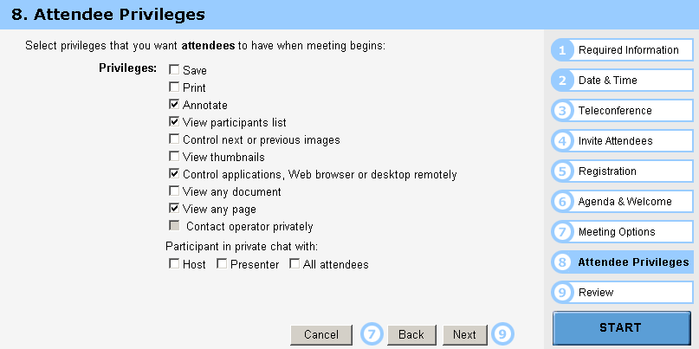
Option-Box
Test cases :
  Class arbitrary value: Random select some options
  Class boundary value: Select all options
  Class boundary value: Select none option
  Class boundary value: Select 1 option

Slide 40
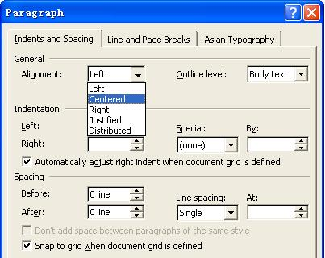
Text-Box
Default
Empty
Blank
Zero
None

Slide 41
Data Structure
Limits on input data - size, type
Limits on output data - size, type
Look for limits such as
  First-1/Last+1
  Start-1/Finish+1
  Min-1/max+1
  Less than empty/ more than full
  just Over/Just Under
  etc
Don’t hesitate to choose data outside boundaries, even when it seems absurd
Notes:
Absurd：荒谬的，违背常理的

Slide 42
Array Reference
The array b has 10 elements.
i = x + 3;
IF b[i] <=5 THEN ,,,
ELSE …
We need three predicates:
b[x + 3] <= 5 – the original predicate
x + 3 >= 1 – not below lower bound
x + 3 >= 10 – not above upper bound

Slide 43
Other types in Boundary
  Numeric
  Character
  Position
  Quantity
  Speed
  Location
  Size
First/last
Min/Max
Star/Finish
Empty/Full
Slower/Faster
Largest/Smallest
Over/Under
Shortest/Longest
… …

Slide 44
On Point and Off Point
The test strategy is a strategy for selecting ON and OFF points, defined as follows:
ON point for a
  Closed border lies on the border
  Open border lies close to the border and satisfies the inequality relation
OFF point
  lies close to the border and on the open side
  does not satisfy the path condition associated with this border

Slide 45
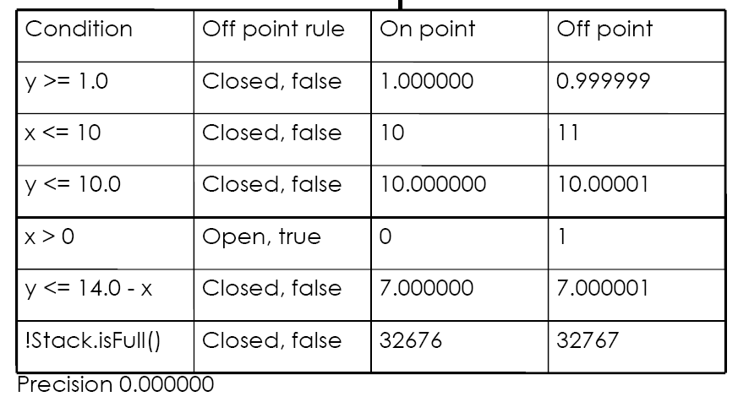
Example

Slide 46
Use of On-OFF Points
OFF
>, <
ON
OFF
=, ><
ON
OFF

Slide 47
On-Off Point Strategy
For testing a closed border we use
  Two ON points to identify the border
  One OFF point, to test that the correct border does not lie on the open side of the border
For testing an open border the role of the ON and OFF points are reversed.
The strategy can be extended to N-dimensional space by using N ON points

Slide 48
On-Off Point Strategy
If the border line has V vertices, we will need
One ON point close to each vertex.
One OFF point per vertex at a uniform distance from the border.
In all cases, it is important that the OFF points are as close as possible to the ON points

Slide 49
Example
Two-dimensional Space
Correct border
OFF
ON
ON
Given border
Example for an open border: ><, < or >. Border outside the line

Slide 50
Example
Two-dimensional Space
Correct border
OFF
ON
ON
Given border
OFF
Example for an closed border: “=“ predicate. Border on the line

Slide 51
Problem of Size
The main problem with this strategy is the cost. Let us assume we have 20 input variables. Then the suggested strategy would need:
For each > or <: 20 ON points and one OFF point
For each = or ><: 20 ON points plus more OFF points

Slide 52
Problem of Precision
The strategy described require the ON points to lie exactly on the border.
For any pair of real numbers, there is always a third real number that lies between them. For a computer, however, this is not the case, due to limited precision.
Thus, there exist borders for which no ON point can be represented in the computer.

Slide 53
Problem of Effectiveness
OFF
Assume that
m1 is the smallest real value
m2 is the largest real value
The length of L, called M, is
M = m2 – m1 +1
P(not detect) = δ / M
δ
>, <
ON
L

Slide 54
Non-linear Border
Everything discussed till now has been based on the assumption that the real border is linear. If this is not true, the domain strategy might fail.
In the example on the next slide, the ON points are on the border, OFF point is off the border but nevertheless the given border is wrong.

Slide 55
Example
Correct border
OFF
ON
ON
Given border

Slide 56
Domain Testing
-revisit
Domain testing, as it is described here, requires that we know how the input partition the input space into input domains.
Thus, it is only possible to use it for small chunks of code.

Slide 57
Predicates
We will assume that all predicates are simple. This implies that they contain only one relational operator. Allowable operators are =, ><, >=, <=, < and >.
Predicates that are not simple can be split into two or more simple predicates.

Slide 58
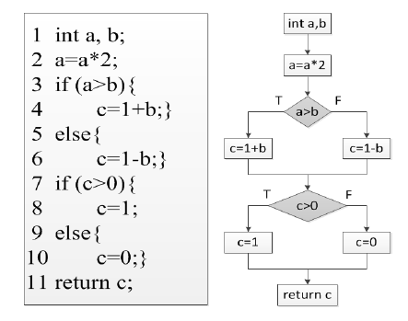
Example

Slide 59
Path Condition
Each path thorough a system is defined by a path condition – the conjunction of all predicates encountered along this path.
An input traverses a path if and only if the path condition is fulfilled.
The path condition defines a path domain, which is the set of all inputs that cause the path to be executed.

Slide 60
Example

Slide 61
Predicate Interpretation
The predicate interpretation of a branch statement is constructed similarly to path condition by skipping other branch statements.
Why to use Predicate Interpretation

Slide 62
Example

Slide 63
Path Domain
A path domain is surrounded by a boundary, consisting of one or more borders where each border corresponds to a predicate.
P1
P1 and P2: {S1, S3,S4}
P1 and not P2: {S1, S3, S5}
not P1 and P2: {S2, S3, S4}
not P1 and not P2: {S2, S3, S5}
S1
S2
S3
P2
S4
S5

Slide 64
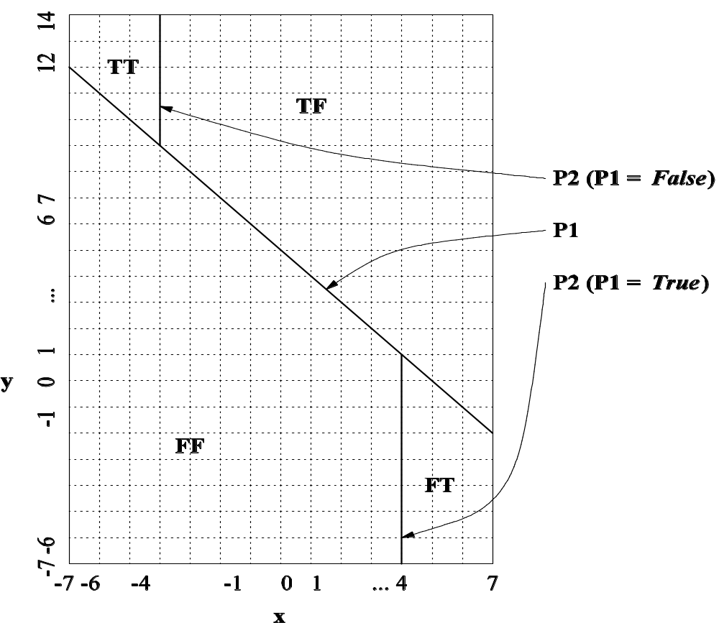
Input Domain Partition
Notes:
Handouts

Slide 65
Path Domain
P1
P1 and P2: {S1, S3,S4}
P1 and not P2: {S1, S3, S5}
not P1 and P2: {S2, S3, S4}
not P1 and not P2: {S2, S3, S5}
S1
S2
S3
P2
S4
S5

Slide 66
Symbolic Execution
The basic idea behind symbolic execution is to use symbolic values instead of concrete data as input.
Test data generation
  Construct path condition by symbolic execution
  Solve path condition by constrain solving
Dynamic symbolic execution

Slide 67
A Simple Algorithm
We can apply domain testing as follows:
Select a test case and run it. This will cause one path to be traversed.
Identify the borders of this path and test them with ON and OFF points
If the OFF point belongs to a new path then this path is selected for testing otherwise check another OFF point.
Terminate when no new path can be found

Slide 68
Domain Error
A domain error occurs if an input traverses the wrong path through the program.
We have no way to know the correct borders and there is no unique correct version of the program.
When domain error occurs along a path, it may be thought of as being caused by one of the given borders being different from the correct one.

Slide 69
BVA for Path Domain
A border is
Closed if defined by a predicate containing =, =< or >=. Closed borders belong to the path domain.
Open if defined by a predicate containing ><, > or >. Open borders do not belong to the path domain.

Slide 70

BVA for Path Domain
Note the difference between open and closed domains.
Closed: what is
on the line belongs
to the domain
Open: what is off the line
– below or above –
belongs to the domain
X
X
X

Slide 71

Q & A

